Slide 1
CON213: Hands-on Kubernetes on AWS
github.com/aws-samples/aws-workshop-for-kubernetes

Slide 2
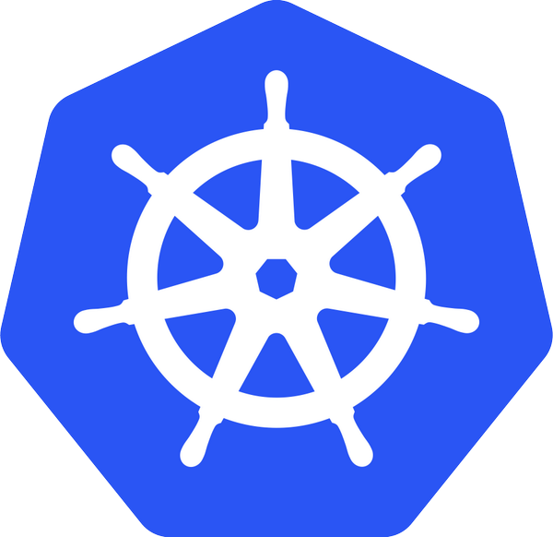

Slide 3
What is Kubernetes?
Ancient Greek word for “helmsman”
Open source orchestration for containers
Docker, rkt, OCI, …
A Cloud Native Computing Foundation (CNCF) project
Active open source project
>29k stars, >1400 contributors, ~11k forks

Slide 4
Declarative primitives
Self-healing
Horizontal scaling
Automatic binpacking
Service discovery and load balancing

Slide 5

Kubernetes concepts
Node
Docker
Pod
Containers
Pods: Co-located group of containers that share an IP, namespace, storage volume
ReplicaSet
#Pods—2
label selector: v1
ReplicaSet
#Pods—1
label selector: v2
Replica Set: Manages the lifecycle of pods and ensures specified number are running
Pod
Pod
Pod
v1
v1
v2
“web”
Service: Single, stable name for a set of pods, also acts as LB
Label: Used to organize and select group of objects
port 8080
port 8080

Slide 6
Kubernetes concepts
Namespaces: “Virtual” clusters for users/projects
Ingress controller: L7 load balancing
Deployments: Declarative version updates
Jobs: Run to completion
Autoscale: Automatically adjust number of Pods
Network Policies: AKA Security Groups for Pods
StatefulSet: Support for long-term stateful distributed systems
More…

Slide 7
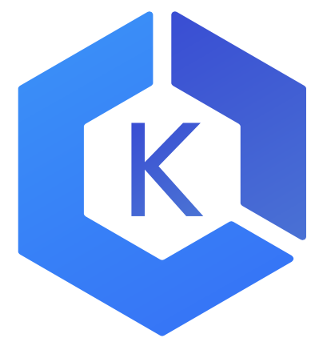
Kubernetes cluster setup—choices
Install, operate, upgrade, delete a Kubernetes cluster
Development—Minikube
Community—Kops
List: kubernetes-aws.io
Enterprise
Elastic Container Service for Kubernetes (EKS)
CoreOS Tectonic
Red Hat OpenShift
Custom
CloudFormation
Terraform
AWS Partners: Docker, Heptio, Mesosphere

Slide 8
Manage a Kubernetes cluster: Kops
Community supported
SIG AWS
Kops office hours and Slack channel
Generate CloudFormation or Terraform scripts
github.com/kubernetes/kops
export AWS_AVAILABILITY_ZONES=${ZONES:-"us-east-1b,us-east-1c,us-east-1d"} export KOPS_STATE_STORE="s3://kubernetes-aws-io" kops create cluster cluster.k8s.local \ --master-count 3 \ --master-size m4.large \ --node-count 5 \ --node-size m4.large \ --zones $AWS_AVAILABILITY_ZONES \ --networking calico \ --yes
Notes:
Calico is an open-source plugin that allows for fine-grained network policy enforcement, ensuring that traffic within your Kubernetes cluster can only flow in the direction that you specify. As an example, if we take a scenario where Kubernetes namespaces are used opt enforce boundaries between products, or even enforce boundaries between different environments (e.g. development vs production), network policies can be configured to ensure no unauthorized network traffic is allowed beyond its boundary. Think of it as being similar to applying Security Groups in the AWS world.

Slide 9
Elastic Container Service for Kubernetes
Managed K8s control plane—highly available master and etcd
Bring your own worker nodes, like ECS
Core tenets
Platform for enterprises to run production-grade workloads
Provides a native and upstream Kubernetes experience
Not forced to use additional AWS services, but offer seamless integration
Actively contributes to the Kubernetes project
APIs
aws eks create-cluster \ --cluster-name <> \ --desired-master-version <> \ --role-arn <>

Slide 10
THANK YOU!

